Slide 1
PROJECT UPDATE

Slide 2
Recap
Forensic Data Analysis - Economic Crime
Adversarial Autoencoder Neural Network
Trained 500 epochs
5 layers
Multi-dimensional anomaly detection
Deploy as a web or mobile application
White paper

Slide 3
What’s New?
Got a reasonable clustering on epoch 433

Slide 4
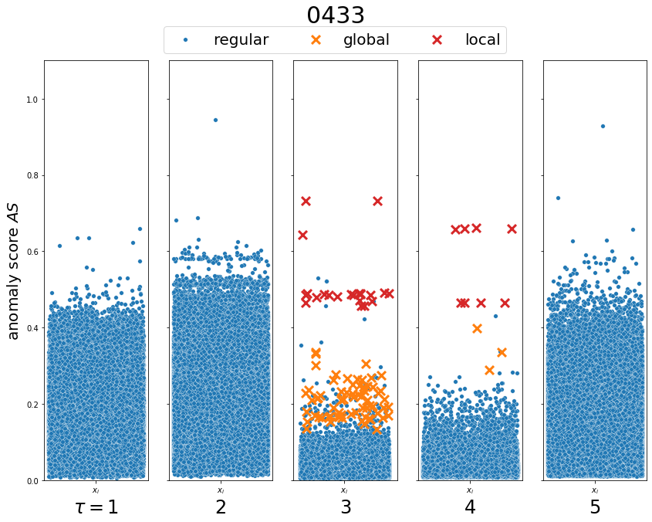

Slide 5
ADVERSARIAL AUTOENCODER RESULTS
 | Actual Local | Actual Global | Actual Regular
Predicted Local | 30 | 0 | 5
Predicted Global | 0 | 70 | 134
Predicted Regular | 0 | 0 | 532,770

Slide 6
ADVERSARIAL AUTOENCODER RESULTS
 | TP | FP | FN | TN | Sensitivity | Specificity | Precision
Local | 30 | 5 | 0 | 532,974 | 1 | 0.99 | 0.86
Global | 70 | 134 | 0 | 532,805 | 1 | 0.99 | 0.34
 | NPV | Miss Rate | Fall Out Rate | False Discovery | False Omission | Accuracy | F1 Score
Local | 1 | 0 | 0.000009 | 0.14 | 0 | 0.99 | 0.92
Global | 1 | 0 | 0.0002 | 0.65 | 0 | 0.99 | 0.51

Slide 7
What’s New?
Got a reasonable clustering on epoch 433
Unable to test model on unseen data using PyTorch
Tried recreating the same code in Keras but failed

Slide 8
What Now?
Stop focusing on the Adversarial Autoencoder Neural Network
Perform other models
kNN
PCA
SVC
DBSCAN
t-SNE
Autoencoder
LSTM Autoencoder
Adversarial Autoencoder

Slide 9
AUTOENCODER & LSTM AUTOENCODER RESULTS
 | Actual Local | Actual Global | Actual Regular
Predicted Local | 0 | 0 | 0
Predicted Global | 0 | 18 | 0
Predicted Regular | 7 | 0 | 133,228

Slide 10
AUTOENCODER & LSTM AUTOENCODER RESULTS
 | TP | FP | FN | TN | Sensitivity | Specificity | Precision
Local | 0 | 0 | 7 | 133,246 | 0 | 1 | 0
Global | 18 | 0 | 0 | 133,235 | 1 | 1 | 1
 | NPV | Miss Rate | Fall Out Rate | False Discovery | False Omission | Accuracy | F1 Score
Local | 0.99 | 1 | 0 | 0 | 0.0005 | 0.99 | 0
Global | 1 | 0 | 0 | 0 | 0 | 1 | 1

Slide 11
REGULAR AUTOENCODER vs LSTM vs ADVERSARIAL
 | Model | F1 Score
Local | Adversarial | 0.92
 | LSTM | 0
 | Autoencoder | 0
Global | Adversarial | 0.51
 | LSTM | 1
 | Autoencoder | 1
* LSTM is slower, but is able to separate the global anomalies further than regular observations

Slide 12
BACKUP

Slide 13
Interview Assignment
Given 600 images of the electronic component, train a machine learning algorithm that could detect the orientation of the electronic component as described below.

Slide 14
ACCEPTABLE
REJECT

Slide 15
Challenges
1 week time-frame
Concurrently with Capstone
600 training observations
11 testing observations
Create a program (.exe file)
Output results in text / html / excel
Develop in Python, deploy in C++
Code in CAFFE, Tensorflow, Keras or PyTorch

